Slide 1

SOFTWARE ENGINEERING
By
R.Vignesh,M.E(Ph.D)
Assistant Professor

Slide 2
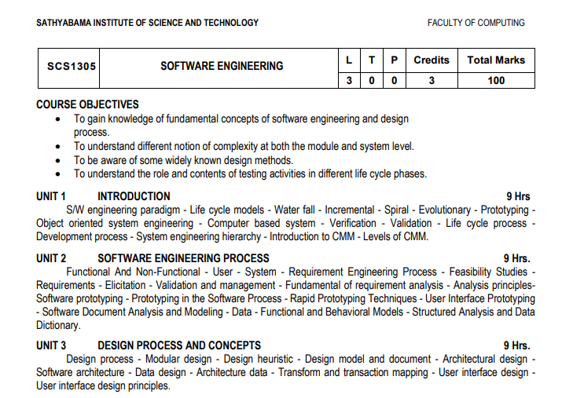
Overall Syllabus

Slide 3
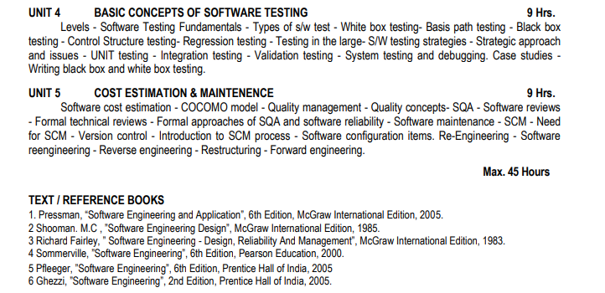

Slide 4
COURSE OUTCOME
CO1 Select appropriate Software Development Lifecycle Model for a given requirement.
CO2 Comprehend various Functional and Non-Functional Requirements.
CO3 Create User Interface using Design concepts.
CO4 Generate Test cases for the developed Code.
CO5 Estimate Cost & Maintenance of the Project.
CO6 Generate an overall plan for a specific application development.

Slide 5
SYLLABUS

Slide 6
Evolving Role of Software
Software Evolution
The process of developing a software product using software engineering principles and methods is referred to as software evolution.
Steps:
Evolution starts from the requirement gathering process.
After which developers create a prototype of the intended software and show it to the users to get their feedback at the early stage of software product development.
The users suggest changes, on which several consecutive updates and maintenance keep on changing too.
This process changes to the original software, till the desired software is accomplished.
Even after the user has desired software in hand, the advancing technology and the changing requirements force the software product to change accordingly.

Slide 7
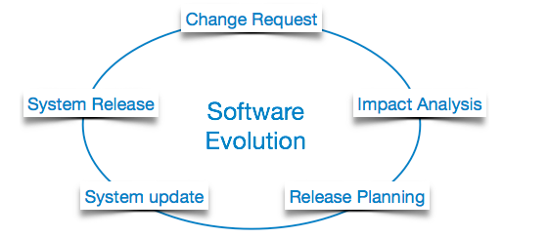
Re-creating software from scratch and to go one-on-one with requirement is not feasible.
The only feasible and economical solution is to update the existing software so that it matches the latest requirements.

Slide 8
Software Evolution Laws
Lehman has given laws for software evolution. He divided the software into three different categories:
S-type (static-type)
This is a software, which works strictly according to defined specifications and solutions.
The solution and the method to achieve it, both are immediately understood before coding.
The s-type software is least subjected to changes hence this is the simplest of all. For example, calculator program for mathematical computation.
P-type (practical-type)
This is a software with a collection of procedures. This is defined by exactly what procedures can do.
In this software, the specifications can be described but the solution is not obvious instantly. For example, gaming software

Slide 9
E-type (embedded-type)
This software works closely as the requirement of real-world environment.
This software has a high degree of evolution as there are various changes in laws, taxes etc. in the real world situations.
For example, Online trading software
Lehman has given eight laws for E-Type software evolution :
Continuing change - An E-type software system must continue to adapt to the real world changes, else it becomes progressively less useful.
Increasing complexity - As an E-type software system evolves, its complexity tends to increase unless work is done to maintain or reduce it.
Conservation of familiarity - The familiarity with the software or the knowledge about how it was developed, why was it developed in that particular manner etc. must be retained at any cost, to implement the changes in the system
.
Continuing growth- In order for an E-type system intended to resolve some business problem, its size of implementing the changes grows according to the lifestyle changes of the business.

Slide 10
Reducing quality - An E-type software system declines in quality unless rigorously maintained and adapted to a changing operational environment.
Feedback systems- The E-type software systems constitute multi-loop, multi-level feedback systems and must be treated as such to be successfully modified or improved.
Self-regulation - E-type system evolution processes are self-regulating with the distribution of product and process measures close to normal.
Organizational stability - The average effective global activity rate in an evolving E-type system is invariant over the lifetime of the product.

Slide 11
Software Paradigms
Software paradigms refer to the methods and steps, which are taken while designing the software
Software Development Paradigm
This Paradigm is known as software engineering paradigms where all the engineering concepts pertaining to the development of software are applied.
It consists of
Requirement gathering
Software design
Programming
Software Design Paradigm
This paradigm is a part of Software Development and includes –
Design
Maintenance
Programming
Programming Paradigm
This paradigm is related closely to programming aspect of software development. This includes
Coding
Testing
Integration

Slide 12
Need of Software Engineering
The need of software engineering arises because of higher rate of change in user requirements and environment on which the software is working.
Large software - It is easier to build a wall than to a house or building, likewise, as the size of software become large engineering has to step to give it a scientific process.
Scalability- If the software process were not based on scientific and engineering concepts, it would be easier to re-create new software than to scale an existing one.
Cost- As hardware industry has shown its skills and huge manufacturing has lower down he price of computer and electronic hardware. But the cost of software remains high if proper process is not adapted.
Dynamic Nature- The always growing and adapting nature of software hugely depends upon the environment in which user works. If the nature of software is always changing, new enhancements need to be done in the existing one. This is where software engineering plays a good role.
Quality Management- Better process of software development provides better and quality software product.

Slide 13
Characteristics of good software
A software product can be judged by what it offers and how well it can be used. This software must satisfy on the following grounds:
Operational
Transitional
Maintenance
Operational
This tells us how well software works in operations. It can be measured on:
Budget
Usability
Efficiency etc..

Slide 14
Transitional
This aspect is important when the software is moved from one platform to another:
Portability
Interoperability
Reusability
Adaptability
Maintenance
This aspect briefs about how well a software has the capabilities to maintain itself in the ever-changing environment:
Modularity
Maintainability
Flexibility
Scalability

Slide 15
Definition-Software Engineering
Software is more than just a program code. A program is an executable code, which serves some computational purpose. Software is considered to be collection of executable programming code, associated libraries and documentations. Software, when made for a specific requirement is called software product.
Engineering on the other hand, is all about developing products, using well-defined, scientific principles and methods
Software engineering is an engineering branch associated with development of software product using well-defined scientific principles, methods and procedures. The outcome of software engineering is an efficient and reliable software product.
OR
Software engineering is a branch of computer science, which uses well-defined engineering concepts required to produce efficient, durable, scalable, in-budget and on-time software products

Slide 16
Life Cycle Models
Software Development Lifecycle (Sdlc)
It is a systematic process for building software that ensures the quality and correctness of the software built.
SDLC process aims to produce high-quality software that meets customer expectations.
The system development should be complete in the pre-defined time frame and cost.
SDLC consists of a detailed plan which explains how to plan, build, and maintain specific software.
Every phase of the SDLC life cycle has its own process and deliverables that feed into the next phase.

Slide 17
Need of SDLC
It offers a basis for project planning, scheduling, and estimating
Provides a framework for a standard set of activities and deliverables
It is a mechanism for project tracking and control
Increases visibility of project planning to all involved stakeholders of the development process
Increased and enhance development speed
Improved client relations
Helps you to decrease project risk and project management plan overhead

Slide 18
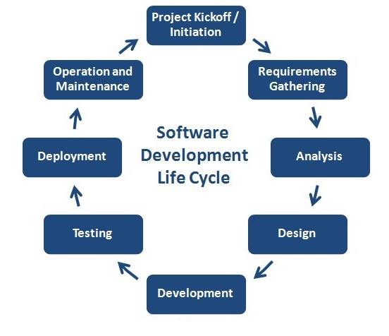
SDLC Phases
The entire SDLC process divided into the following stages:

Slide 19
Phase 1: Requirement collection and analysis:
The requirement is the first stage in the SDLC process.
It is conducted by the senior team members with inputs from all the stakeholders and domain experts in the industry.
Planning for the quality assurance requirements and recognization of the risks involved is also done at this stage.
This stage gives a clearer picture of the scope of the entire project and the anticipated issues, opportunities, and directives which triggered the project.
Requirements Gathering stage need teams to get detailed and precise requirements. This helps companies to finalize the necessary timeline to finish the work of that system.

Slide 20
Phase 2: Feasibility study
Once the requirement analysis phase is completed the next step is to define and document software needs.
This process conducted with the help of 'Software Requirement Specification' document also known as 'SRS' document.
It includes everything which should be designed and developed during the project life cycle.
There are mainly five types of feasibilities checks:
Economic: Can we complete the project within the budget or not?
Legal: Can we handle this project as cyber law and other regulatory framework/compliances.
Operation feasibility: Can we create operations which is expected by the client?
Technical: Need to check whether the current computer system can support the software
Schedule: Decide that the project can be completed within the given schedule or not.

Slide 21
Phase 3: Design
In this third phase, the system and software design documents are prepared as per the requirement specification document. This helps define overall system architecture.
This design phase serves as input for the next phase of the model.
There are two kinds of design documents developed in this phase
High-Level Design (HLD)
Brief description and name of each module
An outline about the functionality of every module
Interface relationship and dependencies between modules
Database tables identified along with their key elements
Complete architecture diagrams along with technology details

Slide 22
Low-Level Design(LLD)
Functional logic of the modules
Database tables, which include type and size
Complete detail of the interface
Addresses all types of dependency issues
Listing of error messages
Complete input and outputs for every module

Slide 23
Phase 4: Coding
Once the system design phase is over, the next phase is coding.
In this phase, developers start build the entire system by writing code using the chosen programming language.
In the coding phase, tasks are divided into units or modules and assigned to the various developers.
It is the longest phase of the Software Development Life Cycle process.
In this phase, Developer needs to follow certain predefined coding guidelines.
They also need to use programming tools like compiler, interpreters, debugger to generate and implement the code.

Slide 24
Phase 5: Testing
Once the software is complete, and it is deployed in the testing environment.
The testing team starts testing the functionality of the entire system. This is done to verify that the entire application works according to the customer requirement.
During this phase, QA and testing team may find some bugs/defects which they communicate to developers.
The development team fixes the bug and send back to QA for a re-test.
This process continues until the software is bug-free, stable, and working according to the business needs of that system.

Slide 25
Phase 6: Installation/Deployment &Phase 7 Maintenance:
Once the software testing phase is over and no bugs or errors left in the system then the final deployment process starts.
Based on the feedback given by the project manager, the final software is released and checked for deployment issues if any.
Phase 7: Maintenance
Once the system is deployed, and customers start using the developed system, following 3 activities occur
Bug fixing - bugs are reported because of some scenarios which are not tested at all
Upgrade - Upgrading the application to the newer versions of the Software
Enhancement Adding some new features into the existing software
The main focus of this SDLC phase is to ensure that needs continue to be met and that the system continues to perform as per the specification mentioned in the first phase.

Slide 26
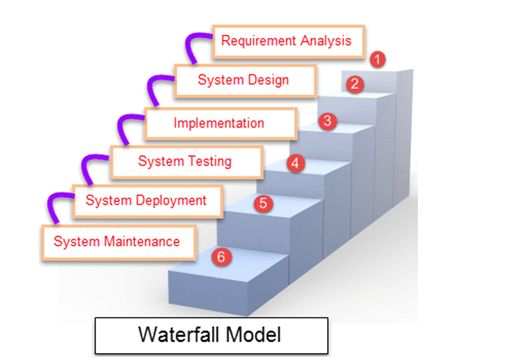
Waterfall model
The waterfall is a widely accepted SDLC model.
In this approach, the whole process of the software development is divided into various phases.
In this SDLC model, the outcome of one phase acts as the input for the next phase.
This SDLC model is documentation-intensive, with earlier phases documenting what need be performed in the subsequent phases.

Slide 27
Phases
Requirement Gathering stage:
During this phase, detailed requirements of the software system to be developed are gathered from client
Design stage
Plan the programming language or database or high level technical details of the project
Build stage
It is nothing but coding the software
Test Stage
In this phase you test the software to verify that is built as per specifications given by client
Deployment stage
Deploy the applications in the respective environment
Maintenance stage
Once your system is ready to use, you may later require change the code as per customers request

Slide 28
Waterfall model can be used when
Requirements are not changing frequently
Application is not complicated and big
Project is short
Requirement is clear
Environment is stable
Technology and tools used are not dynamic and is stable
Resources are available and trained

Slide 29
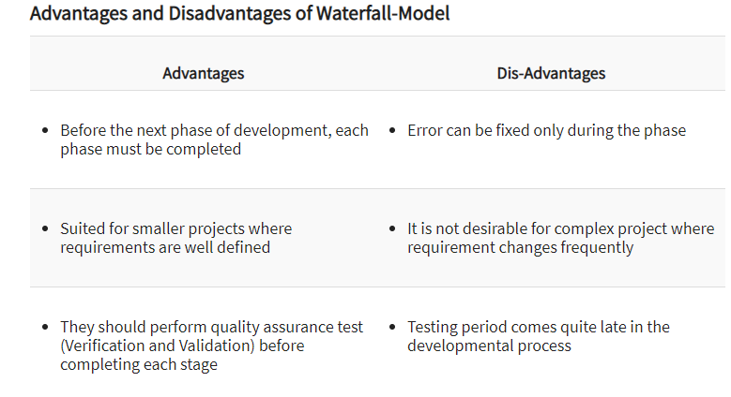

Slide 30
Incremental Approach
The incremental model is not a separate model. It is essentially a series of waterfall cycles.
The requirements are divided into groups at the start of the project. For each group, the SDLC model is followed to develop software.
The SDLC process is repeated, with each release adding more functionality until all requirements are met.
In this method, every cycle act as the maintenance phase for the previous software release.
Modification to the incremental model allows development cycles to overlap.
After that subsequent cycle may begin before the previous cycle is complete

Slide 31
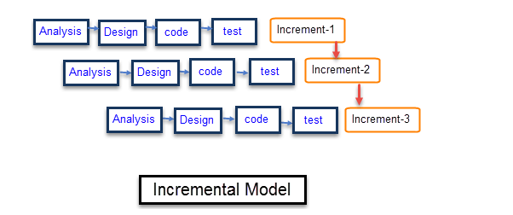
Architecture

Slide 32
Each iteration passes through the requirements, design, coding and testing phases.
And each subsequent release of the system adds function to the previous release until all designed functionality has been implemented.
The system is put into production when the first increment is delivered.
The first increment is often a core product where the basic requirements are addressed, and supplementary features are added in the next increments.
Once the core product is analyzed by the client, there is plan development for the next increment.

Slide 33
Characteristics of an Incremental module includes
System development is broken down into many mini development projects
Partial systems are successively built to produce a final total system
Highest priority requirement is tackled first
Once the requirement is developed, requirement for that increment are frozen

Slide 34
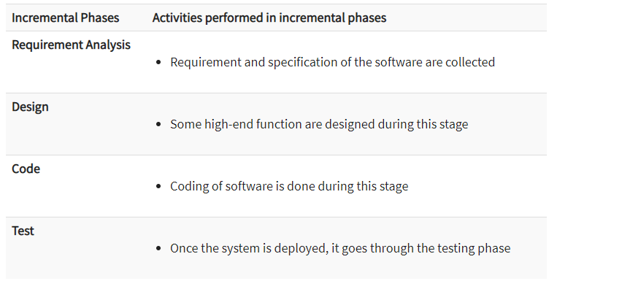

Slide 35
Incremental models are used when
Requirements of the system are clearly understood
When demand for an early release of a product arises
When software engineering team are not very well skilled or trained
When high-risk features and goals are involved
Such methodology is more in use for web application and product based companies

Slide 36
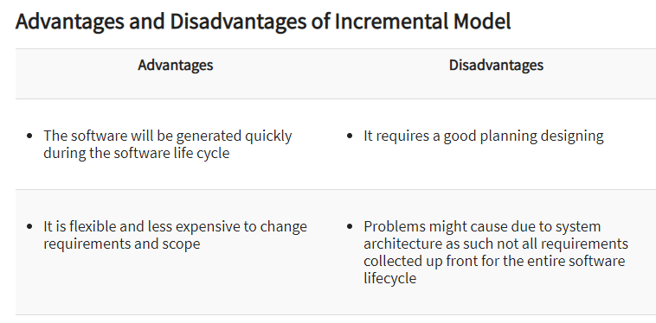

Slide 37
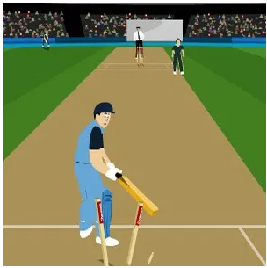
An Example of the Incremental Model:
As you can see in the above example, the core product is a cricket game where only two important players and one umpire is present in the match.

Slide 38
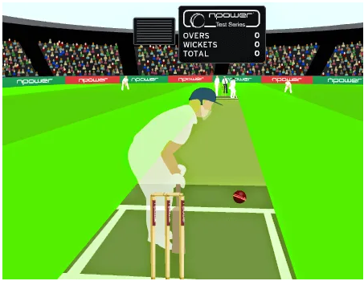
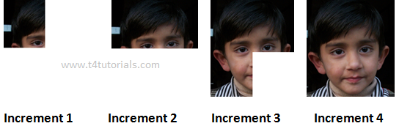
In the next increment, fielders are also added in the game, and thus the increases go on with new features being added with every increment.

Slide 39
S.No | WATERFALL MODEL | INCREMENTAL MODEL
1 | Need of Detailed Documentation in waterfall model is Necessary. | Need of Detailed Documentation in incremental model is Necessary but not too much.
2 | In waterfall model early stage planning is necessary. | In incremental model early stage planning is also necessary.
3 | There is high amount risk in waterfall model. | There is low amount risk in incremental model.
4 | There is long waiting time for running software in waterfall model. | There is short waiting time for running software in incremental model.
5 | Waterfall model can’t handle large project. | Incremental model also can’t handle large project.
6 | Flexibility to change in waterfall model is Difficult. | Flexibility to change in incremental model is Easy.

Slide 40
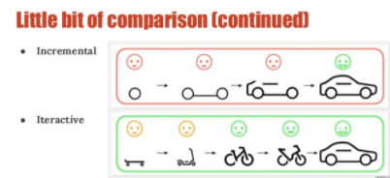
S.No | WATERFALL MODEL | INCREMENTAL MODEL
7 | Returning to previous stage/phase in waterfall model is not possible. | Returning to previous stage/phase in incremental model is possible.
8 | In waterfall model large team is required. | In incremental model large team is not required.
9 | In waterfall model overlapping of phases is not possible. | In incremental model overlapping of phases is possible.
10 | There is only one cycle in waterfall model. | There is multiple development cycles take place in incremental model

Slide 41
Spiral Model
The spiral model is a risk-driven process model.
The spiral model is a combination of sequential and prototype models.
This model is best used for large projects which involve continuous enhancements.
There are specific activities that are done in one iteration (spiral) where the output is a small prototype of the large software.
The same activities are then repeated for all the spirals until the entire software is built.

Slide 42
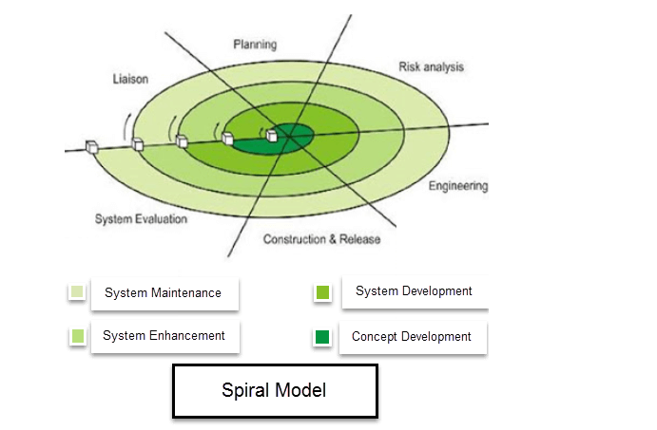

Slide 43
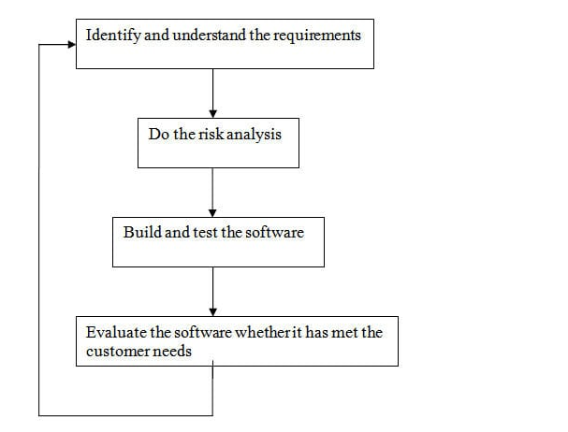

Slide 44
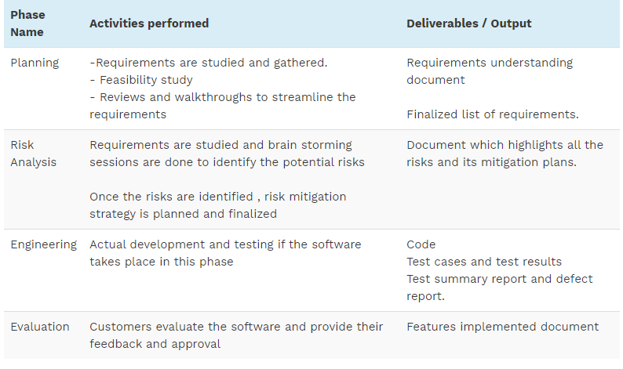

Slide 45
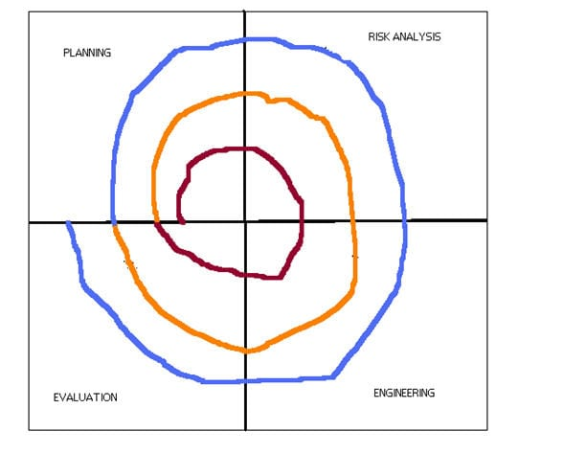
Pictorial Representation of SDLC Spiral Model
Different colors represent different spiral or iteration. For first iteration, represented in brown color , all the 4 activities (Planning, risk analysis, engineering and evaluation) are performed. After the evaluation phase is over for the first iteration (spiral), second iteration (spiral) starts The second iteration, which is represented in orange color, here again all the 4 activities (Planning, risk analysis, engineering and evaluation) are performed. In a similar way, third iteration is done shown in blue color and so on the process continues

Slide 46
Use of Spiral Methodology:
When project is large
When releases are required to be frequent
When creation of a prototype is applicable
When risk and costs evaluation is important
For medium to high-risk projects
When requirements are unclear and complex
When changes may require at any time
When long term project commitment is not feasible due to changes in economic priorities

Slide 47
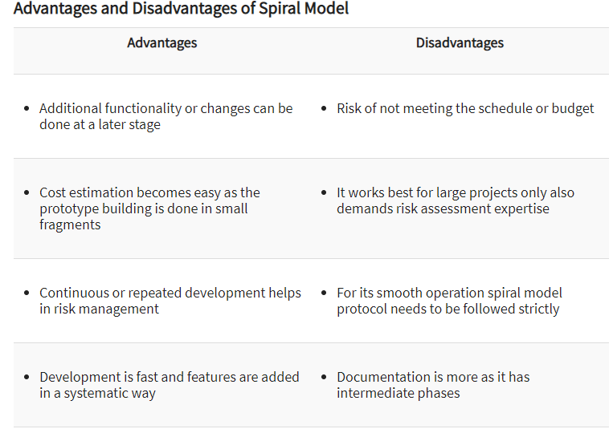

Slide 48
Software Prototyping Model
Prototype Model is one of the most popularly used Software Development Life Cycle Models (SDLC models).
This model is used when the customers do not know the exact project requirements beforehand.
In this model, a prototype of the end product is first developed, tested and refined as per customer feedback repeatedly till a final acceptable prototype is achieved which forms the basis for developing the final product.
In this process model, the system is partially implemented before or during the analysis phase thereby giving the customers an opportunity to see the product early in the life cycle.
In this process model, the system is partially implemented before or during the analysis phase thereby giving the customers an opportunity to see the product early in the life cycle.

Slide 49
The process starts by interviewing the customers and developing the incomplete high-level paper model.
This document is used to build the initial prototype supporting only the basic functionality as desired by the customer.
Once the customer figures out the problems, the prototype is further refined to eliminate them.
The process continues till the user approves the prototype and finds the working model to be satisfactory.

Slide 50
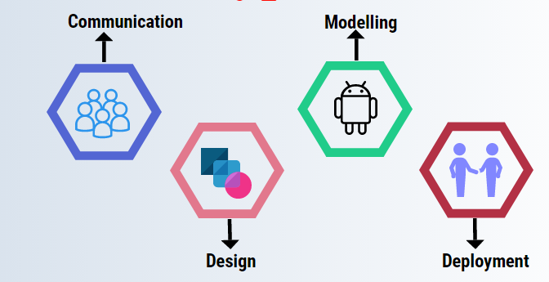

Slide 51
Phases of the Prototyping Model
The different phases are as follow:
Communication:
This is the phase where the developer and Client set up the meeting and talk about the objectives that need to be achieved for the software.
Design:
The design has been done quickly as the requirements are cleared from both ends in providing and receiving end. It is used to construct the prototype.
It includes the important aspects of the software that is input and output but mainly focused on visible aspects than planned activities.
Modeling:
It provides a better idea of the requirement to develop the software and a better understanding of the software product.

Slide 52
Deployment:
Before deployment, the client evaluates the software and if the client is not satisfied then it is refined according to the client’s requirements.
This process goes on until the point client requirements do not accomplish.
After the client’s satisfaction with the product, the product finally deploys to the production environment.
It is thoroughly evaluated and tested, and maintenance is done on a regular basis.
The prototype model mainly works at the high end in below format:
Objectives determination.
Develop the code.
Communication and refine.
Demonstrate.
Test.
Implement.

Slide 53
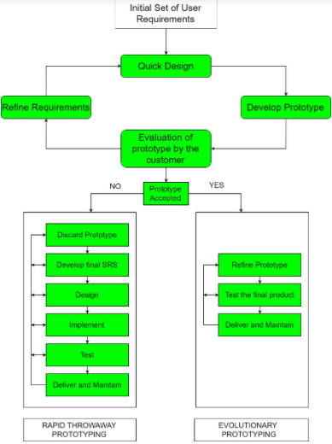

Slide 54
Phases
Prototyping Model has following six SDLC phases as follow:
Step 1: Requirements gathering and analysis
A prototyping model starts with requirement analysis. In this phase, the requirements of the system are defined in detail. During the process, the users of the system are interviewed to know what is their expectation from the system.
Step 2: Quick design
The second phase is a preliminary design or a quick design. In this stage, a simple design of the system is created. However, it is not a complete design. It gives a brief idea of the system to the user. The quick design helps in developing the prototype.
Step 3: Build a Prototype
In this phase, an actual prototype is designed based on the information gathered from quick design. It is a small working model of the required system.

Slide 55
Step 4: Initial user evaluation
In this stage, the proposed system is presented to the client for an initial evaluation. It helps to find out the strength and weakness of the working model. Comment and suggestion are collected from the customer and provided to the developer.
Step 5: Refining prototype
If the user is not happy with the current prototype, you need to refine the prototype according to the user's feedback and suggestions.This phase will not over until all the requirements specified by the user are met. Once the user is satisfied with the developed prototype, a final system is developed based on the approved final prototype.
Step 6: Implement Product and Maintain
Once the final system is developed based on the final prototype, it is thoroughly tested and deployed to production. The system undergoes routine maintenance for minimizing downtime and prevent large-scale failures.

Slide 56
Types of Prototyping Models
Four types of Prototyping models are:
Rapid Throwaway prototypes
Evolutionary prototype
Incremental prototype
Extreme prototype
Rapid Throwaway Prototype
Rapid throwaway is based on the preliminary requirement. It is quickly developed to show how the requirement will look visually. The customer's feedback helps drives changes to the requirement, and the prototype is again created until the requirement is baselined.
In this method, a developed prototype will be discarded and will not be a part of the ultimately accepted prototype. This technique is useful for exploring ideas and getting instant feedback for customer requirements.

Slide 57
Evolutionary Prototyping
Here, the prototype developed is incrementally refined based on customer's feedback until it is finally accepted.
It helps you to save time as well as effort.
That's because developing a prototype from scratch for every interaction of the process can sometimes be very frustrating.
This model is helpful for a project which uses a new technology that is not well understood.
It is also used for a complex project where every functionality must be checked once.
It is helpful when the requirement is not stable or not understood clearly at the initial stage.

Slide 58
Incremental Prototyping:
In incremental Prototyping, the final product is decimated into different small prototypes and developed individually.
Eventually, the different prototypes are merged into a single product.
This method is helpful to reduce the feedback time between the user and the application development team.
Extreme Prototyping:
Extreme prototyping method is mostly used for web development. It is consists of three sequential phases.
Basic prototype with all the existing page is present in the HTML format.
You can simulate data process using a prototype services layer.
The services are implemented and integrated into the final prototype.

Slide 59
Best practices of Prototyping
Here, are a few things which you should watch for during the prototyping process:
You should use Prototyping when the requirements are unclear
It is important to perform planned and controlled Prototyping.
Regular meetings are vital to keep the project on time and avoid costly delays.
The users and the designers should be aware of the prototyping issues and pitfalls.
At a very early stage, you need to approve a prototype and only then allow the team to move to the next step.
In software prototyping method, you should never be afraid to change earlier decisions if new ideas need to be deployed.
You should select the appropriate step size for each version.
Implement important features early on so that if you run out of the time, you still have a worthwhile system

Slide 60
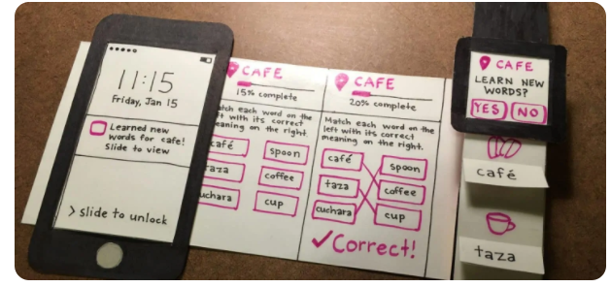
Paper Prototype:
A paper prototype is an example of a throwaway prototype created in the form of rough or hand-sketched drawings of the product’s interface, front-end design, and sometimes the back end work

Slide 61
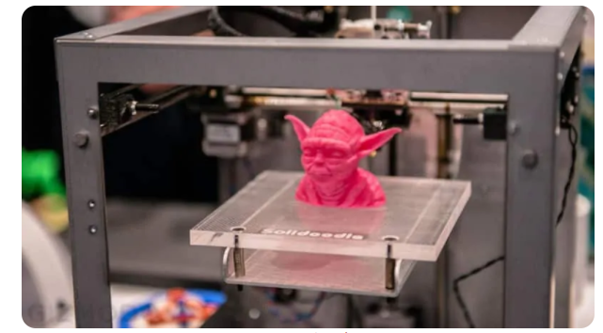
3D print:
The latest technology has made it possible to print a 3d version of your product which can actually work. But this technique is not feasible for mass production.

Slide 62
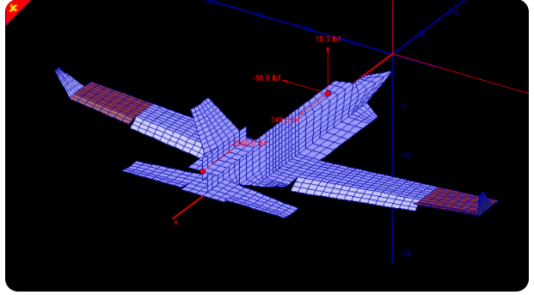
Digital Prototype
A digital prototype allows product developers to create a virtual model of the product which enables them to see how the individual components will work together and how the product will look once it’s completed.
That is, it lets the developers virtually explore the complete product before it’s actually built.

Slide 63
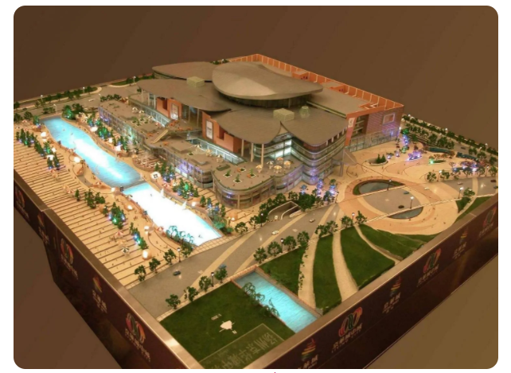
Scale Model
The scale model is a smaller and a non-functional model commonly used for prototyping large products like buildings, automobiles, etc.

Slide 64
Advantages
Here, are important pros/benefits of using Prototyping models:
Users are actively involved in development. Therefore, errors can be detected in the initial stage of the software development process.
Missing functionality can be identified, which helps to reduce the risk of failure as Prototyping is also considered as a risk reduction activity.
Helps team member to communicate effectively
Customer satisfaction exists because the customer can feel the product at a very early stage.
There will be hardly any chance of software rejection.
Quicker user feedback helps you to achieve better software development solutions.

Slide 65
Disadvantages
Here, are important cons/drawbacks of prototyping model:
Prototyping is a slow and time taking process.
The cost of developing a prototype is a total waste as the prototype is ultimately thrown away.
Prototyping may encourage excessive change requests.
Some times customers may not be willing to participate in the iteration cycle for the longer time duration.
There may be far too many variations in software requirements when each time the prototype is evaluated by the customer.
Poor documentation because the requirements of the customers are changing.
It is very difficult for software developers to accommodate all the changes demanded by the clients.
After seeing an early prototype model, the customers may think that the actual product will be delivered to him soon.
The client may lose interest in the final product when he or she is not happy with the initial prototype.
Developers who want to build prototypes quickly may end up building sub-standard development solutions.

Slide 66
S.No. | Spiral Model | Prototype Model
1 | Spiral model is a risk-driven software development model and is made with features of incremental, waterfall or evolutionary prototyping models. | Prototype model is a software development model in which a prototype is built, tested and then refined as per customer needs.
2 | It is also referred to as meta mode | It is also referred to as rapid or closed ended prototype
3 | It takes special care about risk analysis and alternative solution is undertaken | It does not give emphasis on risk analysis.
4 | In spiral model, there is no continuous customer interaction | In prototype model, customer interaction is continuous until the final prototype is approved
5 | It is best suited when the customer requirements are clear. | It is best suited when the requirement of the client is not clear and supposed to be changed

Slide 67
S.No | Spiral Model | Prototype Model
7 | Cost effective quality improvement is not possible. | Cost effective quality improvement is very much possible
8 | In Spiral model, improvement of quality can increase the cost of product. | In Prototype model, improvement of quality does not increases the cost of product

Slide 68
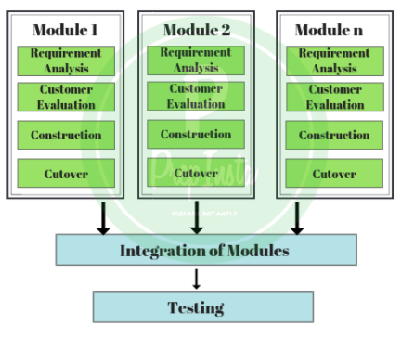
RAD Model

Slide 69
Differences between Various Lifecycle Models
Properties of Model | Water-Fall Model | Incremental Model | Spiral Model | Rad Model
Planning in early stage | Yes | Yes | Yes | No
Returning to an earlier phase | No | Yes | Yes | Yes
Handle Large-Project | Not Appropriate | Not Appropriate | Appropriate | Not Appropriate
Detailed Documentation | Necessary | Yes but not much | Yes | Limited
Cost | Low | Low | Expensive | Low
Requirement Specifications | Beginning | Beginning | Beginning | Time boxed release

Slide 70
Properties of Model | Water-Fall Model | Incremental Model | Spiral Model | Rad Model
Flexibility to change | Difficult | Easy | Easy | Easy
User Involvement | Only at beginning | Intermediate | High | Only at the beginning
Maintenance | Least | Promotes Maintainability | Typical | Easily Maintained
Duration | Long | Very long | Long | Short
Risk Involvement | High | Low | Medium to high risk | Low
Framework Type | Linear | Linear + Iterative | Linear + Iterative | Linear
Testing | After completion of coding phase | After every iteration | At the end of the engineering phase | After completion of coding
Overlapping Phases | No | Yes (As parallel development is there) | No | Yes
Maintenance | Least Maintainable | Maintainable | Yes | Easily Maintainable
Re-usability | Least possible | To some extent | To some extent | Yes

Slide 71
Properties of Model | Water-Fall Model | Incremental Model | Spiral Model | Rad Model
Time-Frame | Very Long | Long | Long | Short
Working software availability | At the end of the life-cycle | At the end of every iteration | At the end of every iteration | At the end of the life cycle
Objective | High Assurance | Rapid Development | High Assurance | Rapid development
Team size | Large Team | Not Large Team | Large Team | Small Team
Customer control over administrator | Very Low | Yes | Yes | Yes

Slide 72
Unified Process (UP)
The Unified Software Development Process or Unified Process is a popular iterative and incremental software development process framework.
The best-known and extensively documented refinement of the Unified Process is the Rational Unified Process (RUP)
The system is developed incrementally over time, iteration by iteration, and thus this approach is also known as iterative and incremental software development.
The iterations are spread over four phases where each phase consists of one or more iterations

Slide 73
Inception Phase
The first and the shortest phase in the project.
It is used to prepare basis for the project, including preparation of business case, establishing project scope and setting boundaries, outlining key requirements, and possible architecture solution together with design tradeoffs, identifying risks, and development of initial project plan—schedule with main milestones and cost estimates.
If the inception phase lasts for too long, it is like an indicator stating that the project vision and goals are not clear to the stakeholders.
With no clear goals and vision the project most likely is doomed to fail.
At this scenario it is better to take a pause at the very beginning of the project to refine the vision and goals.
Otherwise it could lead to unnecessary make-overs and schedule delays in further phases

Slide 74
Elaboration:
During this phase the project team is expected to capture a majority of system’s requirements (e.g., in the form of use cases), to perform identified risk analysis and make a plan of risk management to reduce or eliminate their impact on final schedule and product, to establish design and architecture (e.g., using basic class diagrams, package diagrams and deployment diagrams), to create a plan (schedule, cost estimates, and achievable milestones) for the next (construction) phase.
Constructions:
the longest and largest phase within Unified Process.
During this phase, the design of the system is finalized and refined and the system is built using the basis created during elaboration phase.
The construction phase is divided into multiple iterations, for each iteration to result in an executable release of the system.

Slide 75
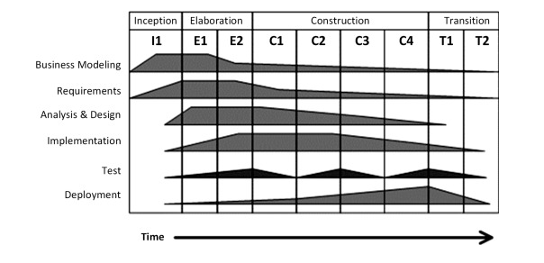
Transition:
The final project phase which delivers the new system to its end-users.
Transition phase includes also data migration from legacy systems and user trainings.
The disciplines and phases of Unified Process are given in above diagram, where the phases are columns and the disciplines are rows.
It clearly shows that the relative effort across disciplines changes over time from iteration to iteration, e.g., initial iterations apply greater relative effort on requirements and design while the latter—more on testing and deployment.

Slide 76
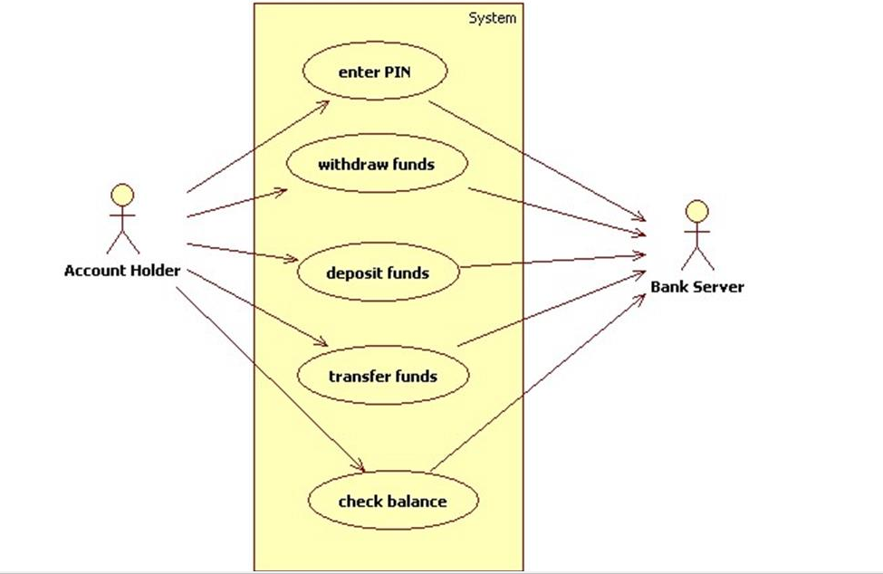
Usecase- defines the interaction between two or more entities
Architectural centric-Blue print of organization of software system
Iterative
Incremental

Slide 77
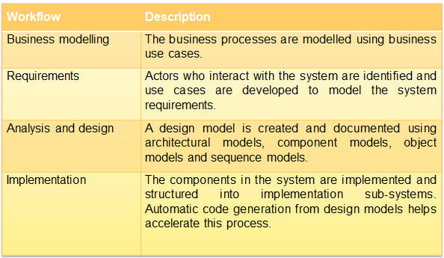
Workflows

Slide 78
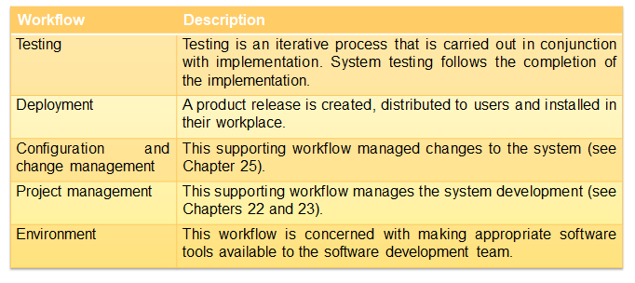

Slide 79
Prescriptive Models or Conventional Models.
Every software engineering organization should describe a unique set of framework activities for the software processes it adopts.
It should populate each framework activity with a set of software engineering actions, and define each action in terms of a task set that identifies the work (and work products) to be accomplished to meet the development goals.
It should then adapt the resultant process model to accommodate the specific nature of each project, the people who will do the work and the environment in which the work will be conducted.
Regardless of the process model that is selected, software engineers have traditionally chosen a generic process framework that encompasses the following framework activities

Slide 80
Communication :This framework activity involves heavy communication and collaboration with the customer (and other stakeholders) and encompasses requirements gathering and related activities
Planning :This activity establishes a plan for the software engineering work that follows. It describes the technical tasks to be conducted, the risks that are likely, the resources that will be required, the work products to be produced, and a work schedule
Modeling:this activity encompasses the creation of models that allow the developer and the customer to better understand software requirements and the design that will achieve those requirements.
Construction :This activity combines code generation (either manual or automated) and the testing that is required to uncover errors in the code.

Slide 81
Deployment: The software (as a complete entity or as a partially completed increment) is delivered to the customer who evaluates the delivered product and provides feedback based on the evaluation.
We call these models prescriptive because they prescribe a set of process elements namely framework activities, software engineering actions, tasks, work products, quality assurance and change control mechanisms for each project.
Each process model also prescribes a workflow that is, the manner in which the process elements are interrelated to one another.
All software process models can accommodate the generic framework activities, but each applies a different emphasis to these activities and defines a workflow that invokes each framework activity (as well as software engineering actions and tasks) in a different manner

Slide 82
Object Oriented System Engineering
In object-oriented software engineering, the software developer identifies and organizes the application in terms of object-oriented concepts, prior to their final representation in any specific programming language or software tools
Phases in Object-Oriented Software Development
The major phases of software development using object–oriented methodology are object-oriented analysis, object-oriented design, and object-oriented implementation.
Object–Oriented Analysis
In this stage, the problem is formulated, user requirements are identified, and then a model is built based upon real–world objects. The analysis produces models on how the desired system should function and how it must be developed.
The models do not include any implementation details so that it can be understood and examined by any non–technical application expert.

Slide 83
Object–Oriented Design
Object-oriented design includes two main stages, namely, system design and object design.
System Design
In this stage, the complete architecture of the desired system is designed.
Systems design is the process of defining the architecture, modules, interfaces, and data for a system to satisfy specified requirements.
Systems design could be seen as the application of systems theory to product development.

Slide 84
Object Design
Object design is the process of planning a system of interacting objects for the purpose of solving a software problem. It is one approach to software design
Eg:Banking system
All the classes required are identified. The designer decides whether
new classes are to be created from scratch,
any existing classes can be used in their original form, or
new classes should be inherited from the existing classes
Besides, the developer designs the internal details of the classes and their associations, i.e., the data structure for each attribute and the algorithms for the operations.

Slide 85
Object–Oriented Implementation and Testing
In this stage, the design model developed in the object design is translated into code in an appropriate programming language or software tool.
The databases are created and the specific hardware requirements are ascertained.
Once the code is in shape, it is tested using specialized techniques to identify and remove the errors in the code
Principles of Object-Oriented Systems
The conceptual framework of object–oriented systems is based upon the object model.
There are two categories of elements in an object-oriented system

Slide 86
Major Elements − By major, it is meant that if a model does not have any one of these elements, it ceases(comes to end) to be object oriented. The four major elements are
Abstraction-displaying only essential information and hiding the details
Encapsulation- wrapping code and data together into a single unit. Eg:Capsule which is mixed of several medicines)
Modularity-Modules can be removed, replaced, or upgraded without affecting other components (eg)Laptop and desktop
Hierarchy- is a group of people or things arranged in order of rank or the people that rank at the top of such a system.
Minor Elements − By minor, it is meant that these elements are useful, but not indispensable part of the object model. The three minor elements are
Typing
Concurrency- means multiple computations are happening at the same time
Persistence-Data that survive over several runs of your program

Slide 87
Computer Based Systems
The elements of computer-based systems are defined as software, hardware, people, database, documentation, and procedures.
A computer-based system makes use of a variety of system elements.
Software: programs, data structures, and related work products.
Hardware: electronic devices that provide computing capabilities.
People: Users and operators of hardware and software.
Database: A large, organized collection of information that is accessed via S/w and persists over time.
Documentation: manuals, on-line help files.
Procedures: the steps that define the specific use of each system element.
One complicating characteristic of computer-based system is that the elements be a part of one system may also represent one macro element of a still large system.
The micro-element is a computer-based system that is one part of a larger computer based system.

Slide 88


Verification
The verifying process includes checking documents, design, code, and program.
Example of verification
In Software Engineering, consider the following specification
A clickable button with name Submet
Verification would check the design doc and correcting the spelling mistake
.
Otherwise, the development team will create a button like
So new specification is
A clickable button with name Submit

Slide 89
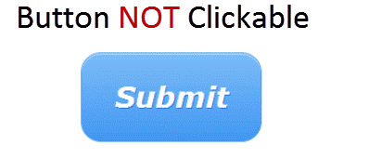
Validation
Validation is a dynamic mechanism of Software testing and validates the actual product.
Once the code is ready, Validation is done. A Validation test found –
Owing to Validation testing, the development team will make the submit button clickable.

Slide 90
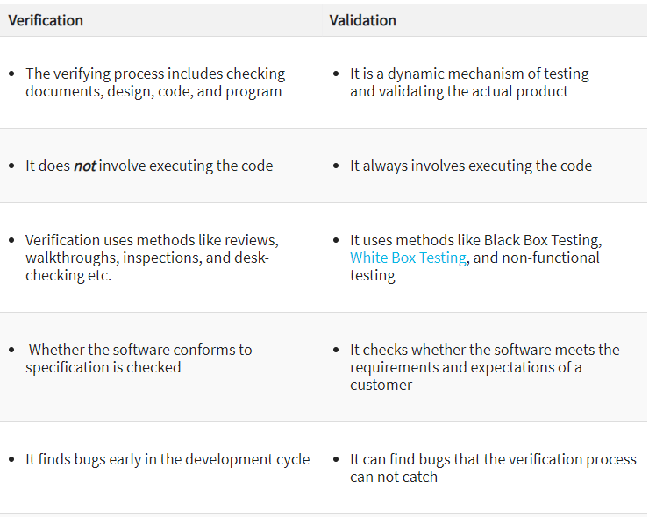
Verification vs Validation

Slide 91
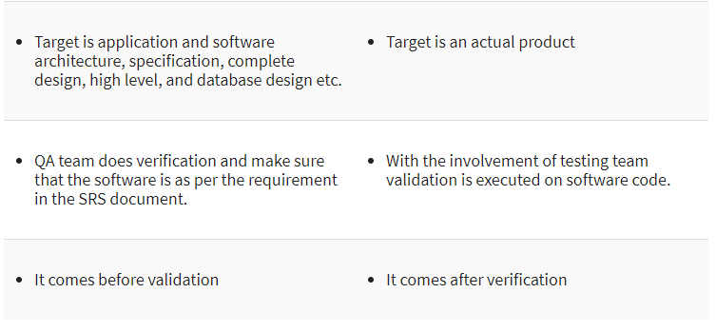
Continue..

Slide 92
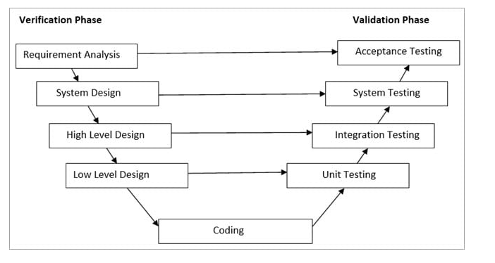
V-Model
V-Model is also known as Verification and Validation Model.
In this model Verification & Validation goes hand in hand i.e. development and testing goes parallel.
V model and waterfall model are the same except that the test planning and testing start at an early stage in V-Model.

Slide 93
Verification Phase:
(i) Requirement Analysis:
In this phase, all the required information is gathered & analyzed. Verification activities include reviewing the requirements.
(ii) System Design:
Once the requirement is clear, a system is designed i.e. architecture, components of the product are created and documented in a design document.
(iii) High-Level Design:
High-level design defines the architecture/design of modules. It defines the functionality between the two modules.
(iv) Low-Level Design:
Low-level Design defines the architecture/design of individual components.
(v) Coding:
Code development is done in this phase.

Slide 94
Validation Phase
(i) Unit Testing:
Unit Testing is performed using the unit test cases that are designed and is done in the Low-level design phase. Unit testing is performed by the developer itself. It is performed on individual components which lead to early defect detection.
(ii) Integration Testing:
Integration testing is performed using integration test cases in High-level Design phase. Integration testing is the testing that is done on integrated modules. It is performed by testers.
(iii) System Testing:
System testing is performed in the System Design phase. In this phase, the complete system is tested i.e. the entire system functionality is tested.
(iv) Acceptance Testing:
Acceptance testing is associated with the Requirement Analysis phase and is done in the customer’s environment.

Slide 95
Advantages and Disadvantages
Advantages of V – Model:
It is a simple and easily understandable model.
V –model approach is good for smaller projects wherein the requirement is defined and it freezes in the early stage.
It is a systematic and disciplined model which results in a high-quality product.
Disadvantages of V-Model:
V-shaped model is not good for ongoing projects.
Requirement change at the later stage would cost too high.

Slide 96
Life Cycle Process
SDLC – is a continuous process, which starts from the moment, when it’s made a decision to launch the project, and it ends at the moment of its full remove from the exploitation.
Basic Stages of Software Development Life Cycle:
Stage 1. Planning and requirement analysis
Each software development life cycle model starts with the analysis, in which the stakeholders of the process discuss the requirements for the final product.
The goal of this stage is the detailed definition of the system requirements. Besides, it is needed to make sure that all the process participants have clearly understood the tasks and how every requirement is going to be implemented.
Often, the discussion involves the QA specialists who can interfere the process with additions even during the development stage if it is necessary.

Slide 97
Stage 2. Designing project architecture
At the second phase of the software development life cycle, the developers are actually designing the architecture.
All the different technical questions that may appear on this stage are discussed by all the stakeholders, including the customer.
Also, here are defined the technologies used in the project, team load, limitations, time frames, and budget.
The most appropriate project decisions are made according to the defined requirements.

Slide 98
Stage 3. Development and programming
After the requirements approved, the process goes to the next stage – actual development.
Programmers start here with the source code writing while keeping in mind previously defined requirements.
The system administrators adjust the software environment, front-end programmers develop the user interface of the program and the logics for its interaction with the server.
The programming by itself assumes four stages
Algorithm development
Source code writing
Compilation
Testing and debugging

Slide 99
Stage 4. Testing
The testing phase includes the debugging process.
All the code flaws missed during the development are detected here, documented, and passed back to the developers to fix.
The testing process repeats until all the critical issues are removed and software workflow is stable.

Slide 100
Stage 5. Deployment
When the program is finalized and has no critical issues – it is time to launch it for the end users.
After the new program version release, the tech support team joins.
This department provides user feedback; consult and support users during the time of exploitation.
Moreover, the update of selected components is included in this phase, to make sure, that the software is up-to-date and is invulnerable to a security breach.

Slide 101
System Engineering
Software engineering occurs as a consequence of a process called system engineering.
The overall objective of the system must be determined:
The role of hardware, software, people, database, procedures, and other system elements must be identified
Operational requirements must be elicited/extracted, analyzed, specified, modeled, validated, and managed.
These activities are the foundation of system engineering.
System engineering is a modeling process.
To construct a system model, the engineer should consider a number of factors:
Assumptions
Simplifications
Limitations
Constraints
Preferences

Slide 102
Assumptions:Reduce the number of possible permutations and variations.
Simplifications: enable the model to be created in a timely manner.
Limitations: Help to bound the system.
Constraints: Will guide the manner in which the model is created and the approach taken when the model is implemented.
Preferences: Indicate the preferred architecture for all data, functions, and technology.

Slide 103
System Engineering Hierarchy
System engineering encompasses a collection of top-down and bottom-up methods to navigate the hierarchy
For software development this means creating a "world view" and progressively narrowing its focus until all technical detail is known.
Within a specific domain, the need for targeted system elements is analyzed.
Finally, the analysis, design, and construction of targeted system element is initiated.
Broad context is established at the top of the hierarchy and at the bottom, detailed technical activities are conducted.
It is important for a system engineer narrows the focus of work as one moves downward in the hierarchy.

Slide 104
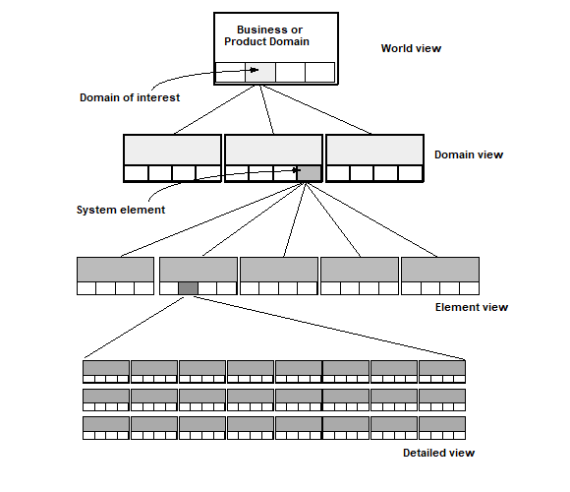

Slide 105
The world view (WV) is composed of a set of domains (D1), which can each be a system or system of systems in its own right WV = {D1 D2 D3………,Dn }
Each domain is composed of specific elements (Ej) each of which serves some role in accomplishing the objective and goals of the domain and component: Di = {E1 E2 E3 …… Em}
Finally, each element is implemented by specifying the technical components (Ck) that achieve the necessary function for an element: Ej = {C1, C2 C3 …….. C k}
In the software context, a component could be a computer program, a reusable program component, a module, a class or object, or even a programming language statement.

Slide 106
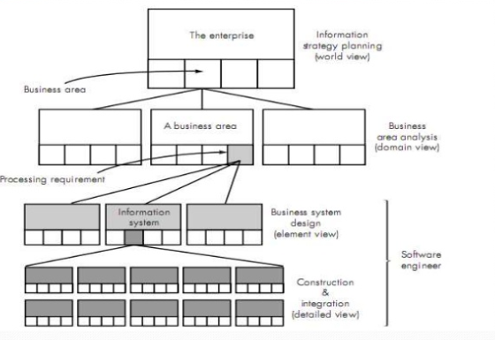

Slide 107
Business Process Engineering: An Overview
The goal of Business Process Engineering (BPE) is to define architectures that will enable a business to use information effectively.
BPE is one process for creating an overall plan for implementing the computing architecture
Three architectures must be analyzed and designed within the context of business objectives and goals:
Data Architecture
It provides a framework for the information needs of a business or business function
Applications architecture
It encompasses those elements of a system that transform objects within the data architecture for business purpose
Technology Infrastructure
It provides foundation for data and application architectures. Infrastructure encompasses hardware and software that are used to support the application and data

Slide 108
Product Engineering: An Overview
Emphasize that software engineers participate in all levels of the product engineering process that begins with requirements engineering.
The analysis step maps requirements into representations of data, function, and behavior.
The design step maps the analysis model into data, architectural, interface, and software component designs.

Slide 109
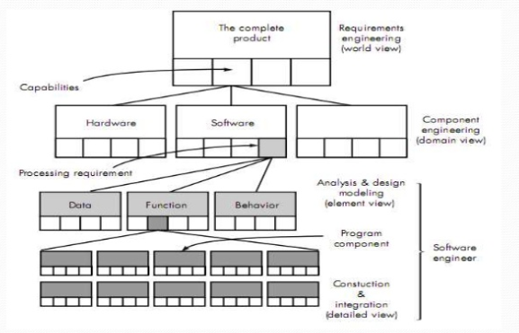

Slide 110
The Goal of product Engineering is to translate the customer's device for a set of defined capabilities into a working product
Architecture consists of 4 components
Software
Hardware
data
People
Business Process Reengineering
It is Iterative like other business process
Business goals and the process that achieve them must be adopted to a changing business environment

Slide 111
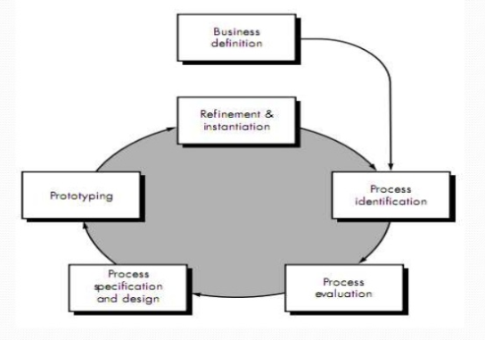

Slide 112
The model defines 6 activities
Business Definition
Business goals are identified within context of four key drivers-Cost reduction, time reduction,quality environment and personal development,empowerment
Process Identification
Process defined in the business process are identified,then ranked by importance for re engineering activity
Process Evaluation
Existing process is analyzed and measured,cost and time consumed from the tasks are noted and quality/performance process are isolated

Slide 113
Process specification and design:
Use cases prepared each process is re designed based on first three activities
Prototyping
A redesigned must be prototyped before it is fully integrated into the business
Refinement
Based on the feedback from the prototype, business process are refined

Slide 114
System Modeling
System modeling is an important element of the system engineering process. Whether the focus is on the world view or the detailed view, the engineer creates models that:
• Define the process that serves the needs of the view under consideration.
• Represent the behavior of the processes and the assumption on which the behavior is based.
To construct a system model, the engineer should consider a number of restraining factors:
1. Assumption that reduce the number of possible permutations and variations, thus enabling a model to reflect the problem in a reasonable manner.
2. Simplifications that the model has to create in a timely manner.
3. Limitations that help to bound the system.
4. Constraints that will guide the manner in which the model is created and the approach taken when the model is implemented.
5. Preference that indicate the preferred architecture for all data, functions, and technology.

Slide 115
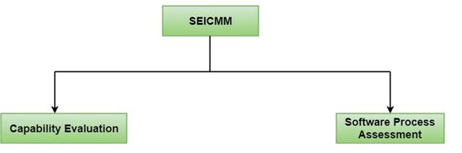
Capability Maturity Model
The Capability Maturity Model (CMM) is a procedure used to develop and refine an organization's software development process.
Capability Maturity Model is used as a benchmark to measure the maturity of an organization's software process.
CMM was developed and is promoted by the Software Engineering Institute (SEI), a research and development center promote by the U.S. Department of Defense (DOD)
Methods of SEICMM
There are two methods of SEICMM:

Slide 116
Capability Evaluation:
Capability evaluation provides a way to assess the software process capability of an organization.
The results of capability evaluation indicate the likely contractor performance if the contractor is awarded a work.
Therefore, the results of the software process capability assessment can be used to select a contractor.
Software Process Assessment:
Software process assessment is used by an organization to improve its process capability.
Thus, this type of evaluation is for purely internal use.

Slide 117
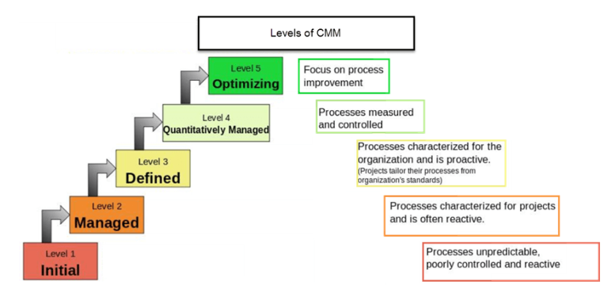
CMM Levels

Slide 118
Level 1: Initial
Ad hoc activities characterize a software development organization at this level.
Very few or no processes are described and followed.
Since software production processes are not limited, different engineers follow their process and as a result, development efforts become chaotic.
Therefore, it is also called a chaotic level.
Level 2: Repeatable
At this level, the fundamental project management practices like tracking cost and schedule are established.
Size and cost estimation methods, like function point analysis, COCOMO, etc. are used.

Slide 119
Level 3: Defined
At this level, the methods for both management and development activities are defined and documented. There is a common organization-wide understanding of operations, roles, and responsibilities.
The ways through defined, the process and product qualities are not measured. ISO 9000 goals at achieving this level.
Level 4: Managed
At this level, the focus is on software metrics. Two kinds of metrics are composed.
Product metrics measure the features of the product being developed, such as its size, reliability, time complexity, understandability, etc.
Process metrics follow the effectiveness of the process being used, such as average defect correction time, productivity, the average number of defects found per hour inspection, the average number of failures detected during testing per LOC, etc.
The software process and product quality are measured, and quantitative quality requirements for the product are met.

Slide 120
Various tools like Pareto charts, fishbone diagrams, etc. are used to measure the product and process quality.
The process metrics are used to analyze if a project performed satisfactorily.
Thus, the outcome of process measurements is used to calculate project performance rather than improve the process.
Level 5: Optimizing
At this phase, process and product metrics are collected. Process and product measurement data are evaluated for continuous process improvement.

Slide 121
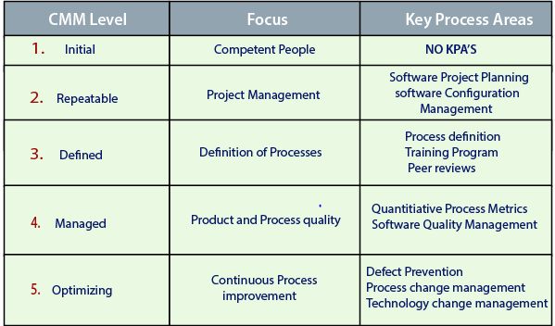
Key Process Areas (KPA) of a software organization
Except for SEI CMM level 1, each maturity level is featured by several Key Process Areas (KPAs) that contains the areas an organization should focus on improving its software process to the next level. The focus of each level and the corresponding key process areas are shown in the following table

Slide 122
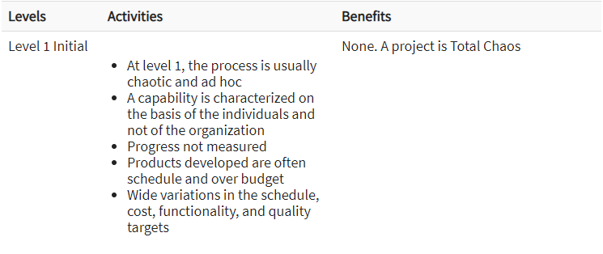

Slide 123
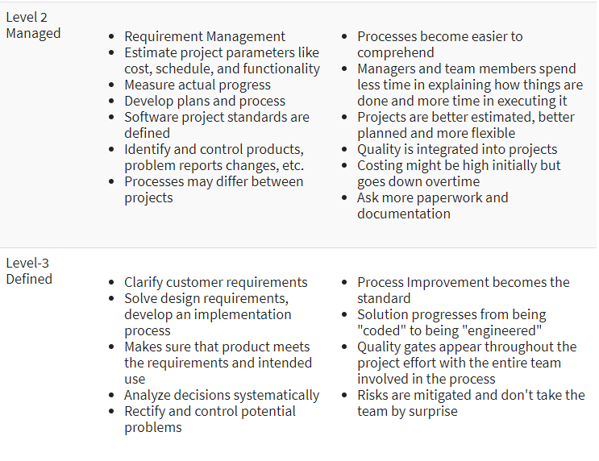

Slide 124
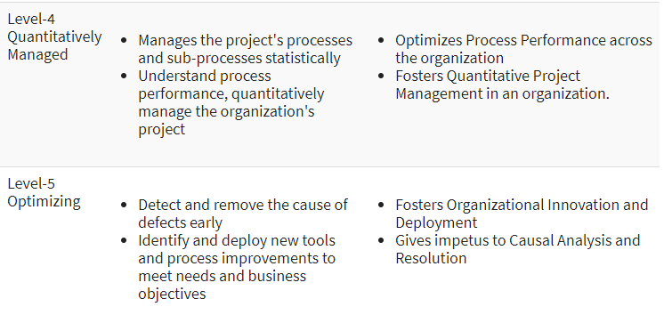

Slide 125
Use of CMM:
Today CMM act as a "seal of approval" in the software industry. It helps in various ways to improve the software quality.
It guides towards repeatable standard process and hence reduce the learning time on how to get things done
Practicing CMM means practicing standard protocol for development, which means it not only helps the team to save time but also gives a clear view of what to do and what to expect
The quality activities gel well with the project rather than thought of as a separate event
It acts as a commuter between the project and the team
CMM efforts are always towards the improvement of the process

Slide 126
Limitations
CMM determines what a process should address instead of how it should be implemented
It does not explain every possibility of software process improvement
It concentrates on software issues but does not consider strategic business planning, adopting technologies, establishing product line and managing human resources
It does not tell on what kind of business an organization should be in
CMM will not be useful in the project having a crisis right now

